Slide 1

Imperium Assist “Assisting people to gain power in a time of crisis”
DRAFT
Energetic Imperials

Slide 2
Storyboard for… Imperium Assist Mobile App created by Group A3 #19 Energetic Imperials will be creating an app that assists people in a time of crisis. This app will help people stay connected to others, have professionals to discuss mental health challenges with and keep updated with changes in the current climate and news. At this stage, the app would be primarily based around support for those who have tested positive to COVID-19 with the opportunity to use it for other health issues and crisis’s in the future. Due to the current climate people around the world are living in and our recognition of individuals struggling with the isolation associated with COVID-19. “IMPERIUM MEANS ABSOLUTE POWER” – ASSISTING PEOPLE TO GAIN POWER IN A TIME OF CRISIS

Slide 3
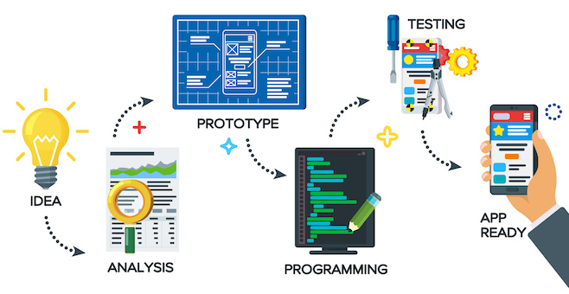
Overall structure

Slide 4

Mobile App Objective
The app has been designed to help people through this hard virus time we are experiencing in Australia at the moment and Globally in the future.
The app will help people stay connected to others, have professionals to discuss mental health challenges with and keep updated with changes in the current climate and news. At this stage, the app would be primarily based around support for those who have tested positive to COVID-9 with the opportunity to use it for other health crisis’s in the future.
The app will need to be started from scratch and will be compatible to any Android or IOS device, you can just download it and have access to support chat rooms with others in similar situations, mental health professionals such as psychologists, access to handy tips and tricks to get through the crisis such as isolation essentials for COVID-19 and access to government updates and news about the crisis.
“Imperium means absolute power and that is what we are trying to do here, assist people to gain power in this time of crisis.”
Mobile
4:40 PM
50%
Back
Sydney
Done
7 August 2020
Imperium Assist
Imperium means absolute power
Do you want to gain your power back
in this time of crisis
Sign up or Sign In

Slide 5




Description of App
Our app will include the following features within different tabs in the app:
1. Access via a chat room or phone number to mental health professionals for help for those users who are struggling with the many different aspects involved with a crisis like COVID-19. Users will be able to turn notifications on for this section if they have chosen to message a health professional so they can see when they receive replies. Examples of the struggles that professionals may be able to help with include depression due to isolation and a such a large change in lifestyle, anxiety from the economic and social environment, abusive relationships from trapped environments etc.
2. A chatline where users can interact with other individuals who may also feel isolated due to a positive test or who are struggling with their symptoms or lack thereof. People will be able to chat to others in the same or similar situation as themselves, either as themselves or anonymously if they so choose. Hopefully, this chat system will allow users to talk about their experiences and troubles associated with COVID-19 and find people that are in similar situations to them to help each other feel supported and less isolated. This section will also allow for notifications to be turned on if a user wishes to know when another user has replied to them.
3. A section where people can upload handy tips and tricks to help others get through COVID-19 in a successful and positive way. This may be lists of essentials for a 14-day isolation period for those either testing positive or being in contact with COVID-19 or those returning from overseas. This section may also include lists of activities or projects that others have found enjoyable through their isolation periods.
4. A volunteer’s section where those who are healthy and able to access goods and services and want to help those struggling can access and offer help and support. This may include things such as picking up essential supplies for people and dropping them to their houses or even doing game or puzzle swaps for people in isolation.
5. A government update and news section that includes the current COVID-19 restrictions that are in place within the user’s area as well as any government updates, press releases and news updates for the current crisis. Notifications for this section may be turned on to allow people to have real time updates of the COVID-19 environment.
Mobile
4:40 PM
50%
Back
Sydney
Done
7 August 2020
COVID
News
Chat
Gov Update
Volunteer

Slide 6
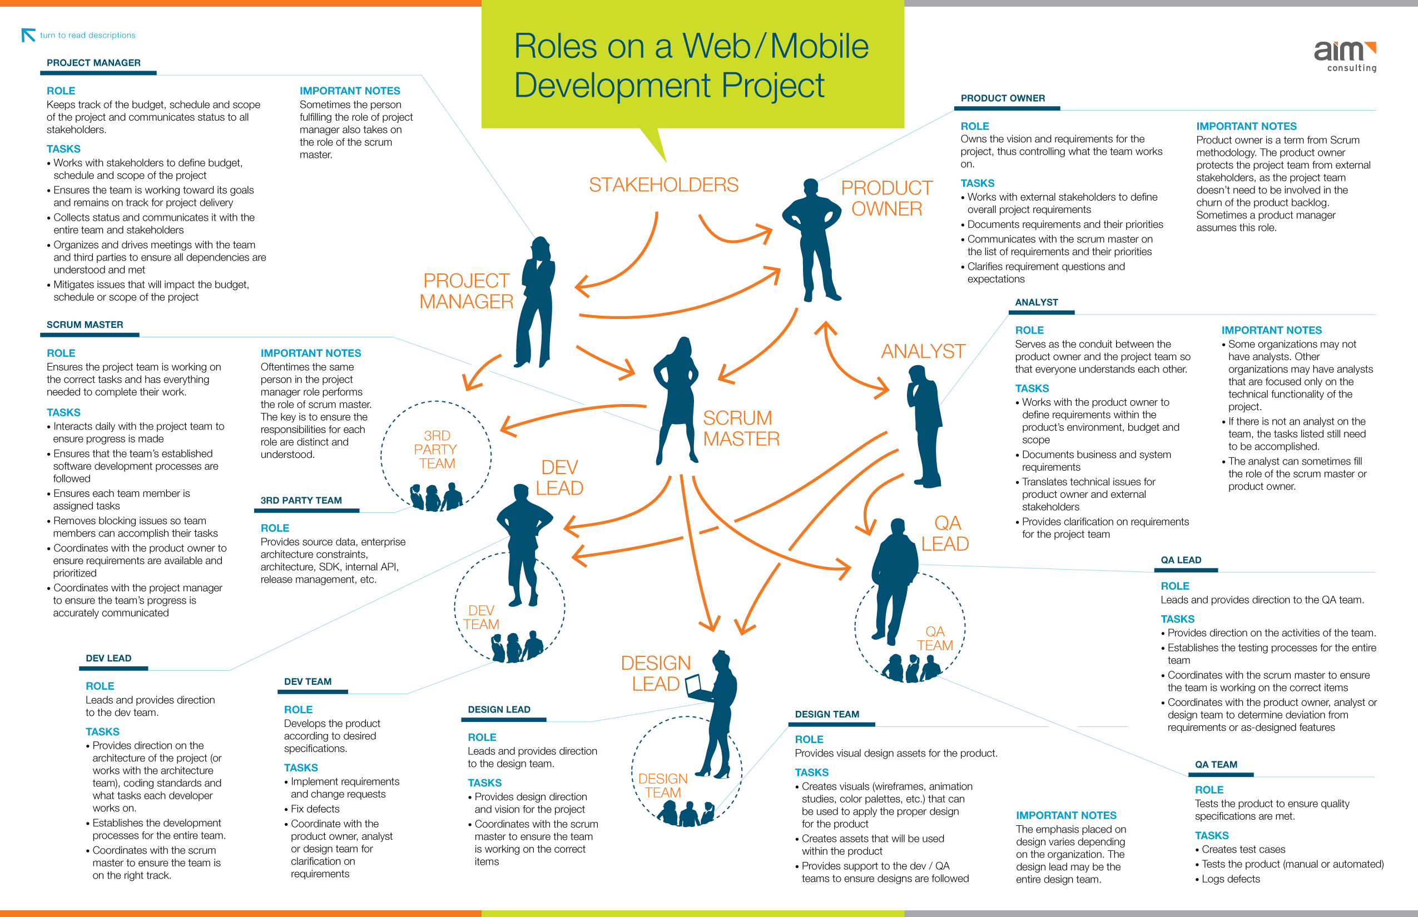
Project Team Project Manager Scrum Master Develop Lead Develop Team Design Lead Design Team Product Owner Analyst QA Lead QA Team

Slide 7





List of Features
Sign-up
Login
Onboarding
Splash Screen
Navigation
Image
Forms
Social Feeds
Booking systems
Calendar Integrations
Push Notifications
Maps
Covid Updates
News Updates
Chat Room
Government Updates
Volunteer
Mental Health Specialists
FUNDED BY BOTH THE GOVERNMENT AND HEALTH ORGANISATIONS
Email
Your Email
ABSOLUTELY FREE
Sign In
Sign Up
UPGRADE TO PREMIUM
COVID
News
Chat
Gov Update
Volunteer
USER FRIENDLY

Slide 8
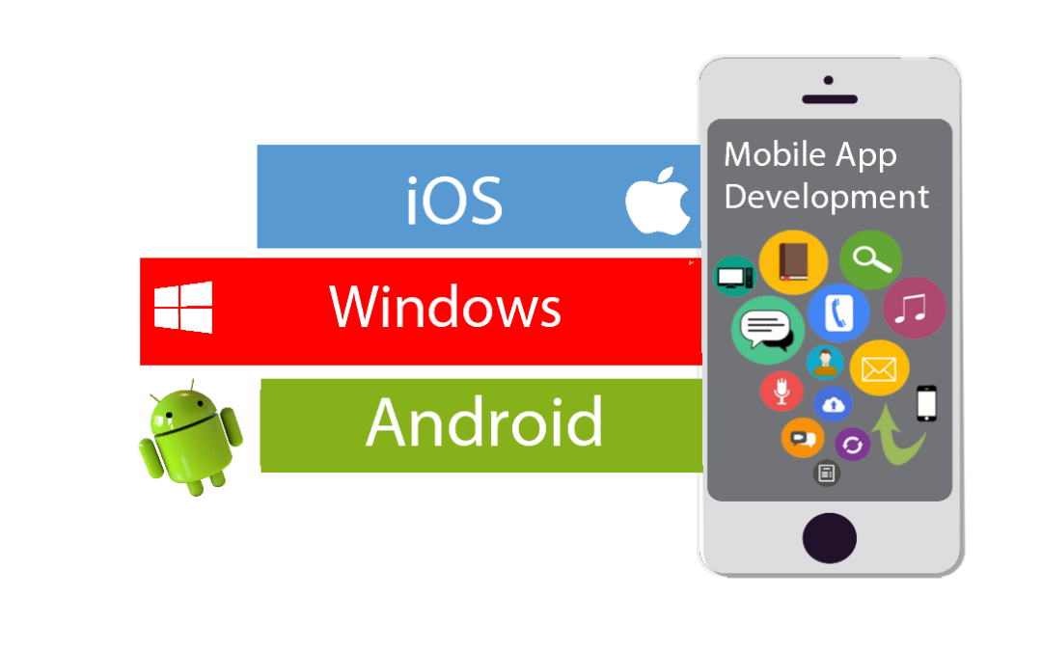
Platform – Tools – Technologies App will be compatible with both Android and IOS and Windows In order to successfully make this app our team needs to have: • Modern coding languages such as HTML5, Java, C++, Objective-C, Swift and or C# • Skills in cloud infrastructure e.g. Microsoft Azure or Amazon Web Services • Cross platform capabilities e.g. able to adapt to Android, iOS or Windows • Skills in data engineering • A way to make the app secure e.g. OAuth • Good team cohesion including open and clear communication, clear goals and efficient leadership

Slide 9
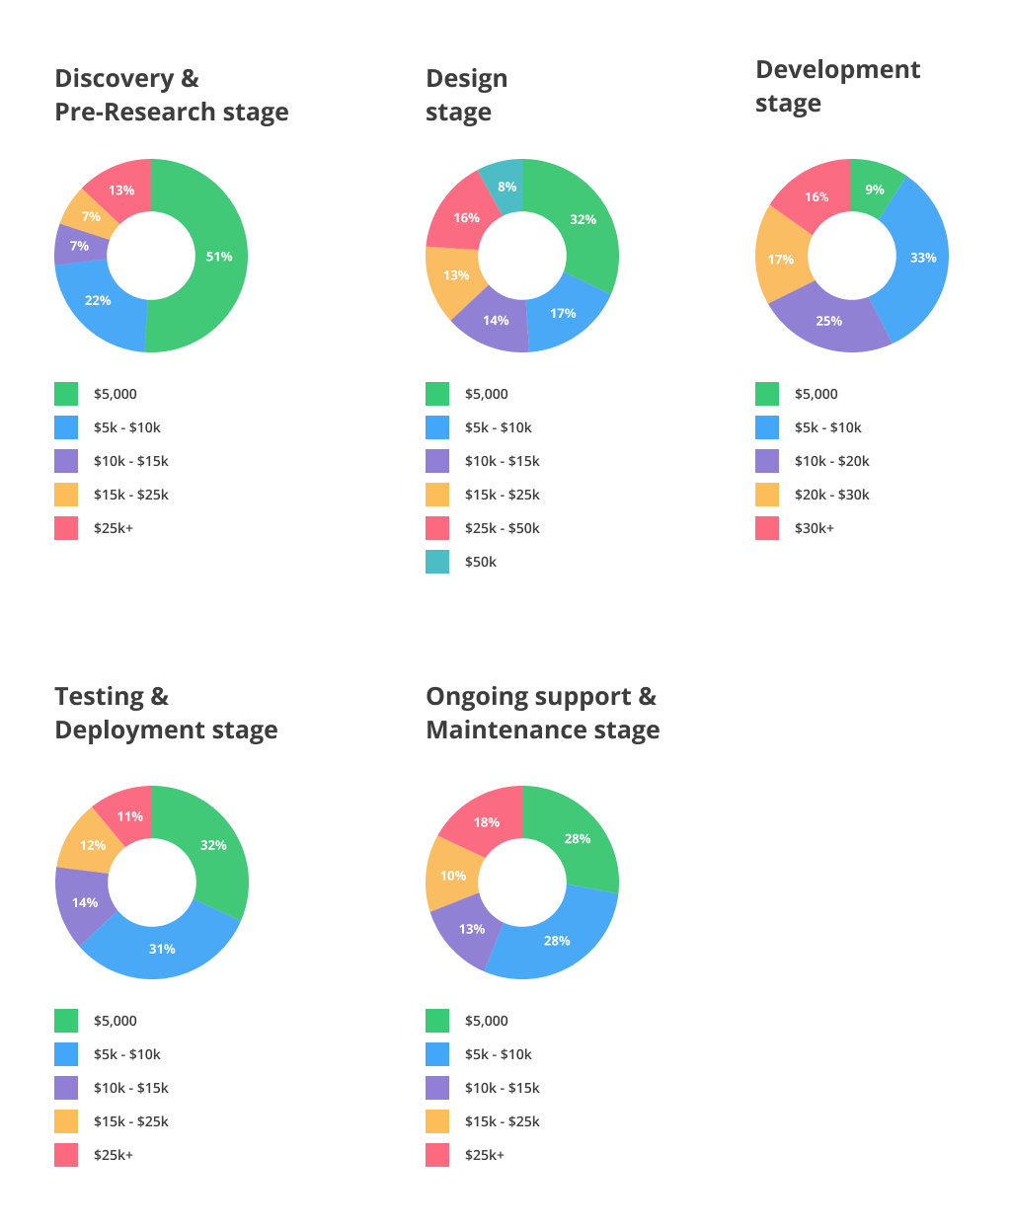
Estimated Budget and Timeframe for Development
Estimated Timeframe
Software Requirements and Design: 2-4 weeks
Software App Planning: 1-2 weeks
Software App Development: 3-6 months
Software App Testing: 3-6 weeks

Slide 10
Outcome “A successful outcome will be an app that helps those living in the current COVID-19 climate have a less isolated, less traumatic and information enriched experience. The success of the app will also see less people struggling with mental illness that originally predicted when we eventually get though the COVID-19 pandemic”
Energetic Imperials

Slide 11

Sign In / Sign Up
Mobile
4:40 PM
50%
Back
Sydney
Done
7 August 1.31PM
Leverage agile frameworks to provide
Email
Your Email
Iterative approaches to corporate strategy
Sign In
Override the digital divide with additional
Sign Up

Slide 12
User Control Screen
Mobile
4:40 PM
50%
Back
San Francisco
Done
Leverage agile frameworks to provide
James Smith
26 July 6:26 AM
Hey J, we still on for 11?
You
Yeah, remind me again what this meeting is about. I’m drawing a complete blank!
James Smith
Podcasting operational change management inside of workflows to establish a framework.
Override the digital divide with additional
Popular
New
Chat
Explore
Options

Slide 13
Description of the App
Mobile
4:40 PM
50%
Back
San Francisco
Done
James Smith
26 July 6:26 AM
Hey J, we still on for 11?
You
Yeah, remind me again what this meeting is about. I’m drawing a complete blank!
James Smith
Podcasting operational change management inside of workflows to establish a framework.
Popular
New
Chat
Explore
Options

Slide 14
Sign In / Sign Up
Mobile
4:40 PM
50%
Leverage agile frameworks to provide
Back
San Francisco
Done
26 July 6:26 AM
Iterative approaches to corporate strategy
Email
Your Email

Slide 15
Sign In / Sign Up
Back
San Francisco
Done
26 July 6:26 AM
Iterative approaches to corporate strategy
Email
Your Email
Sign In
Leverage agile frameworks to provide
Sign Up
Popular
New
Chat
Explore
Options

Slide 16


Main Screens
Mobile
4:40 PM
50%
Mobile
4:40 PM
50%
Mobile
4:40 PM
50%
Back
San Francisco
Done
Back
San Francisco
Done
26 July 6:26 AM
26 July 6:26 AM
James Smith
Post Photo
Hey J, we still on for 11?
You
Yeah, remind me again what this meeting is about. I’m drawing a complete blank!
Email
Your Email
James Smith
Podcasting operational change management inside of workflows to establish a framework.
Sign In
James Smith
Sign Up
15 Likes
Popular
New
Chat
Explore
Options
Popular
New
Chat
Explore
Options

Slide 17
New Features
Collaboratively administrate empowered markets via plug-and-play networks.
Dynamically procrastinate B2C users after installed base benefits.
Dramatically visualize customer directed convergence without revolutionary ROI.
Override the digital divide with additional clickthroughs from DevOps.
Nanotechnology immersion along the information highway will close the loop on focusing solely on the bottom line.
Mobile
4:40 PM
50%
Mobile
4:40 PM
50%
Back
San Francisco
Done
Back
San Francisco
Done
26 July 6:26 AM
26 July 6:26 AM
James Smith
Post Photo
Hey J, we still on for 11?
You
Yeah, remind me again what this meeting is about. I’m drawing a complete blank!
James Smith
Podcasting operational change management inside of workflows to establish a framework.
James Smith
15 Likes
Popular
New
Chat
Explore
Options
Popular
New
Chat
Explore
Options

Slide 18
New Features
Collaboratively administrate empowered markets via plug-and-play networks.
Dynamically procrastinate B2C users after installed base benefits.
Dramatically visualize customer directed convergence without revolutionary ROI.
Override the digital divide with additional clickthroughs from DevOps.
Nanotechnology immersion along the information highway will close the loop on focusing solely on the bottom line.
Mobile
4:40 PM
50%
Email
Your Email
Sign In
Sign Up

Slide 19
New Features
Collaboratively administrate empowered markets via plug-and-play networks.
Dynamically procrastinate B2C users after installed base benefits.
Dramatically visualize customer directed convergence without revolutionary ROI.
Override the digital divide with additional clickthroughs from DevOps.
Nanotechnology immersion along the information highway will close the loop on focusing solely on the bottom line.
Mobile
4:40 PM
50%
Back
San Francisco
Done
26 July 6:26 AM
James Smith
Hey J, we still on for 11?
You
Yeah, remind me again what this meeting is about. I’m drawing a complete blank!
James Smith
Podcasting operational change management inside of workflows to establish a framework.
Popular
New
Chat
Explore
Options

Slide 20
New Features
Collaboratively administrate empowered markets via plug-and-play networks.
Dynamically procrastinate B2C users after installed base benefits.
Dramatically visualize customer directed convergence without revolutionary ROI.
Override the digital divide with additional clickthroughs from DevOps.
Nanotechnology immersion along the information highway will close the loop on focusing solely on the bottom line.
Mobile
4:40 PM
50%
Back
San Francisco
Done
26 July 6:26 AM
Post Photo
James Smith
15 Likes
Popular
New
Chat
Explore
Options

Slide 21

Landscape Mode
Post Photo
James Smith
15 Likes
Hey are you online?

Slide 22
Landscape Mode
Collaboratively administrate empowered markets via plug-and-play networks.
Dynamically procrastinate B2C users after installed base benefits.
Dramatically visualize customer directed convergence without revolutionary ROI.
Override the digital divide with additional clickthroughs from DevOps.
Nanotechnology immersion along the information highway will close the loop on focusing solely on the bottom line.
Post Photo
James Smith
15 Likes
Hey are you online?

Slide 23
Landscape Mode
Collaboratively administrate empowered markets via plug-and-play networks.
Dynamically procrastinate B2C users after installed base benefits.
Dramatically visualize customer directed convergence without revolutionary ROI.
Override the digital divide with additional clickthroughs from DevOps.
Nanotechnology immersion along the information highway will close the loop on focusing solely on the bottom line.
James Smith
15 Likes
Hey are you online?

Slide 24
Wireframe Kit
Assets and Resources

Slide 25



















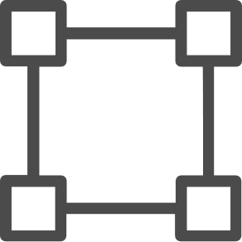







































Native iOS

Slide 26













































Native Material Design

Slide 27
Callout Lines

Slide 28






iOS Controls
4:40 PM
Active Button
Radio Button Option Label
4:40 PM
Secondary Button
Radio Button Option Label
Mobile
4:40 PM
50%
Mobile
4:40 PM
50%
Inactive Button
Radio Button Option Label
Back
San Francisco
Done
26 July 6:26 AM
Back
San Francisco
Done
Text Label
Traditional Checkbox Not Selected
26 July 6:26 AM
Text Field
Traditional Checkbox Selected
Popular
New
Chat
Explore
Options
Traditional Radio Button Out
Picker Option 2
Traditional Radio Button Selected
Popular
New
Chat
Explore
Options
iOS Picker Options
Search
Clear
Picker Option 4
Search
Clear
One
Two
Three
One
Two
Three
Bring to the table win-win survival strategies to ensure proactive domination. Generation X is on the runway heading towards a streamlined cloud solution.
NOTIFICATION
9m ago
One
Two
Three
Select
Select All
Paste

Slide 29


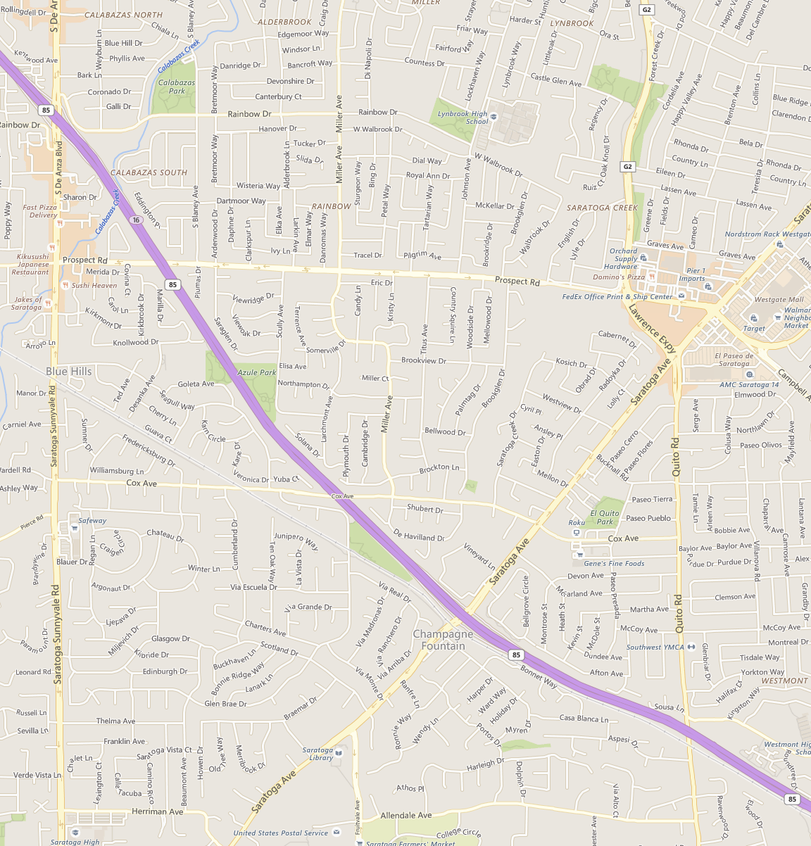


iOS Controls
q
w
e
r
t
y
u
i
o
p
James Smith
James Smith
a
s
d
f
g
h
j
k
l
Hey J, we still on for 11?
Hey J, we still on for 11?
z
x
c
v
b
n
m
James Smith
James Smith
123
space
return
Yeah, remind me again what this meeting is about. I’m drawing a complete blank!
Yeah, remind me again what this meeting is about. I’m drawing a complete blank!
q
w
e
r
t
y
u
i
o
p
a
s
d
f
g
h
j
k
l
James Smith
James Smith
z
x
c
v
b
n
m
Podcasting operational change management inside of workflows to establish a framework.
Podcasting operational change management inside of workflows to establish a framework.
123
space
return
q
w
e
r
t
y
u
i
o
p
a
s
d
f
g
h
j
k
l
z
x
c
v
b
n
m
123
space
return
q
w
e
r
t
y
u
i
o
p
a
s
d
f
g
h
j
k
l
z
x
c
v
b
n
m
123
space
return

